Slide 1
Introduction to audio coding
Xavier Serra

Slide 2
Audio coding or audio compression algorithms are used to obtain compact digital representations of high-fidelity (wideband) audio signals for the purpose of efficient transmission or storage. The central objective in audio coding is to represent the signal with a minimum number of bits while achieving transparent signal reproduction, i.e., generating output audio that cannot be distinguished from the original input, even by a sensitive listener (“golden ears”). (Spanias et al., 2007)

Slide 3
Index
Sampling and quantization
Types of audio coders
Audio coder attributes
Example audio codecs

Slide 4
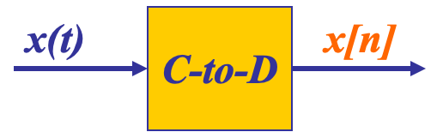
Sampling
SAMPLING PROCESS
Convert x(t) to numbers x[n], where n is an integer index
SAMPLING RATE (fs)
fs =1/Ts, samples per second, units of fs are Hertz
Uniform sampling at t = nTs = n/fs; x[n] = x(nTs)=x(n/fs)
= x(nTs)

Slide 5
Storing digital sound
x[n] is a SAMPLED SIGNAL
A list of numbers stored in memory
EXAMPLE: audio CD
Sampling rate: 44,100 samples per second (Hz)
Bit depth: 16-bit samples
Number of channels: 2 channels
Bitrate: 2 X 16 X 44100 = 1411.2 Kbit/s

Slide 6
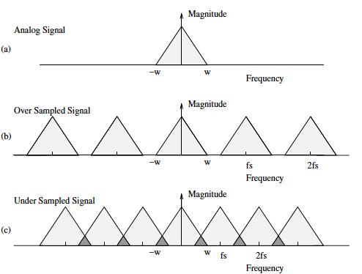
Sampling theorem (by Shannon)
A continuous-time signal x(t) with frequency no higher than fmax (w) can be reconstructed exactly from its samples x[n] = x(nTs) if the samples are taken at a rate fs = 1/Ts that is greater than 2fmax

Slide 7
Types of audio coders
Lossless vs lossy
Lossless coders achieve compression rations from 2:1 to 4:1.
Lossy coders exploit perceptual irrelevant information, achieving 10:1 to 25:1 compression ratios.
Linear predictive coders
Exploit short- and long-term correlations of signal using source-filter representations.
Mainly used for speech signals.
Transform and subband coders
Mainly use time-frequency transforms (DFT, DCT, …).
Mostly used in MPEG coders and include perceptual models.
Sinusoidal
Based on sinusoidal model.
Neural coders
Based on deep learning.

Slide 8
Audio coder attributes
Audio quality: various perceptual assessment methods (ex. noise-to-mask ratio, perceptual audio quality measure, perceptual evaluation, ..).
Bit rate: measured as kb/s.
Computational complexity: related to real-time implementation, measured in MIPS (millions of instructions per second).
Codec delay: up to 100-200 ms for network applications and 10-20 ms for two-way real-time communication.
Error robustness: need to deal with noisy time-varying channels, like for streaming audio over Internet.

Slide 9
Example audio coders
Pulse code modulation (.wav)
Lossless coding (.flac)
Perceptual coding (.mp3)
Advanced audio coding (.aac)
Neural audio coding (.ecddc)

Slide 10
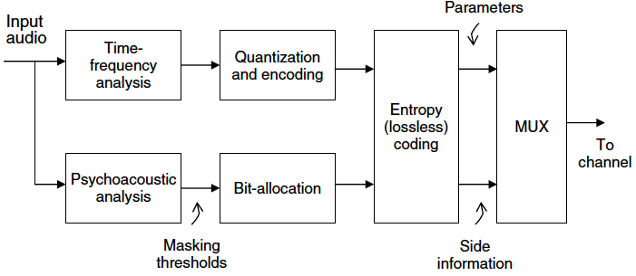
Generic perceptual audio encoder

Slide 11
Uncompressed audio as stored on an audio-CD has a bit rate of 1,411.2 kbit/s, (16 bit/sample × 44,100 samples/second × 2 channels / 1,000 bits/kilobit).
Perceptual codecs like MP3 achieve bit rates like 128, 160, and 192 kbit/s, representing compression ratios of approximately 11:1, 9:1 and 7:1 respectively.
Neural audio codecs like Encodec reach bit rates of 1.5 to 24 kbit/s, representing compression ratios of approximately 940:1 to 60:1.

Slide 12
References
“Chapter 1: Introduction” in Andreas Spanias, Ted Painter, and Venkatraman Atti (2007). Audio Signal Processing and Coding. John Wiley & Sons, Inc.
https://github.com/xserra/audio-coding-materials/
examples/sound-display.ipynb
examples/downsample-chirp.ipynb
examples/resample.ipynb
examples/mp3-coding.ipynb

